Slide 1
Patriotic Artwork
Looking at the details, from the images at this time period.

Slide 2
Looking at an image in a different Light
When looking at art the artist is trying to portray a message.
The artwork also shows people an image that can be powerful.
Ask why did the artist paint the way he did.
Also look at the colors the tones and analyze the overall pieces of art.
Artwork helps give people a clear understanding in what people feel. It helps us as human beings reflect.

Slide 3
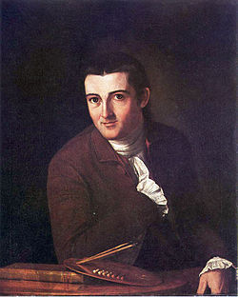
Looking at the artist
When looking at art we must know the content and context of the painting. The content is the subject matter, and the context is the time period of when the painting was created. We will look at a couple of examples of an artist that created artwork during the ending part of the American Revolutionary war.
Name is John Trumbell the portrait is self-painted in 1777.

Slide 4
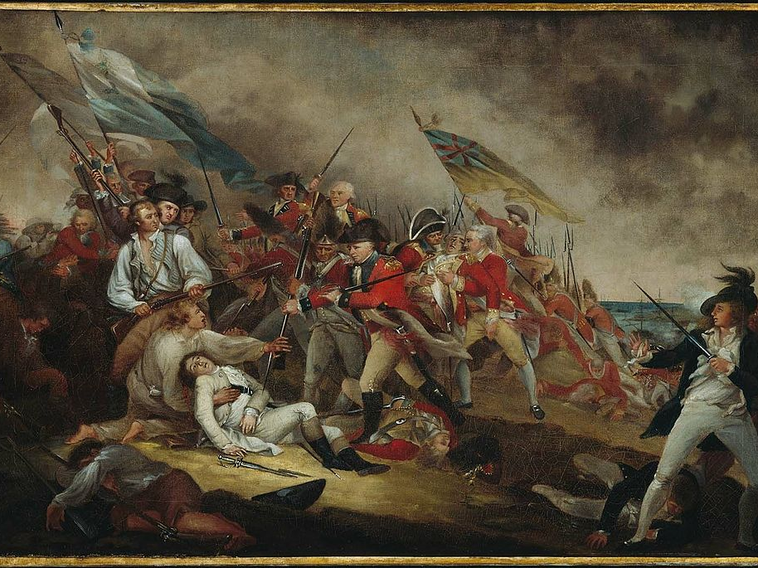
The Death of General Warren at the Battle of Bunker Hill
event 1775, painted 1786 John Trumbull - From the Boston Museum of Fine Arts. When looking at the artwork notice the colors the. Also the space and the atmosphere the paintings gives to the viewer.

Slide 5
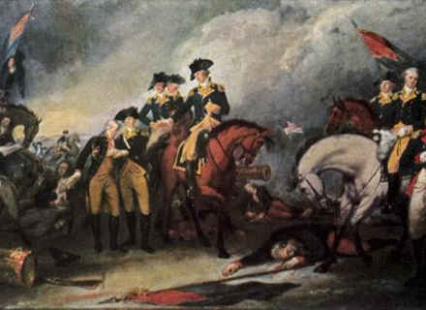
Trenton Surrender John Trumbell 1785
Capture of the Hessians at the Battle of Trenton .The surrender by the Hessian troops at the Battle of Trenton. Notice in this painting the darkness is not so distinct compared to the first one.

Slide 6
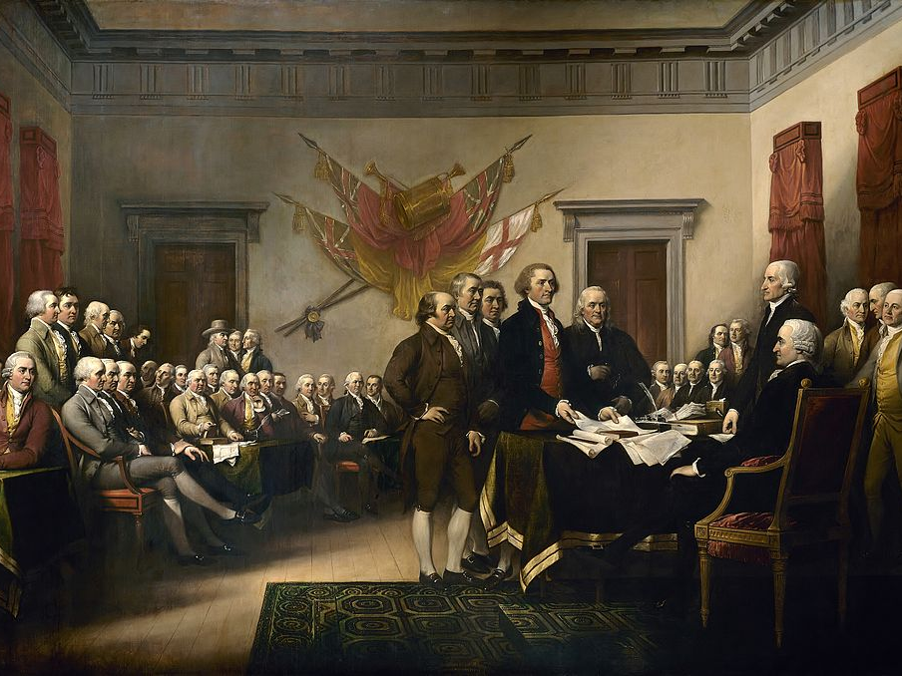
Declaration of Independence John Trumbell 1819.
It gives order and a sense of pride. When looking at the image notice the people descending in the background in which gives a sense of space. The reason that I say it has a sense of pride is because the group presenting the document grabs your attention. I feel also the image gives a strong presence to it as well. Look at the large group of people present for this document. It says we are stronger when working together.

Slide 7
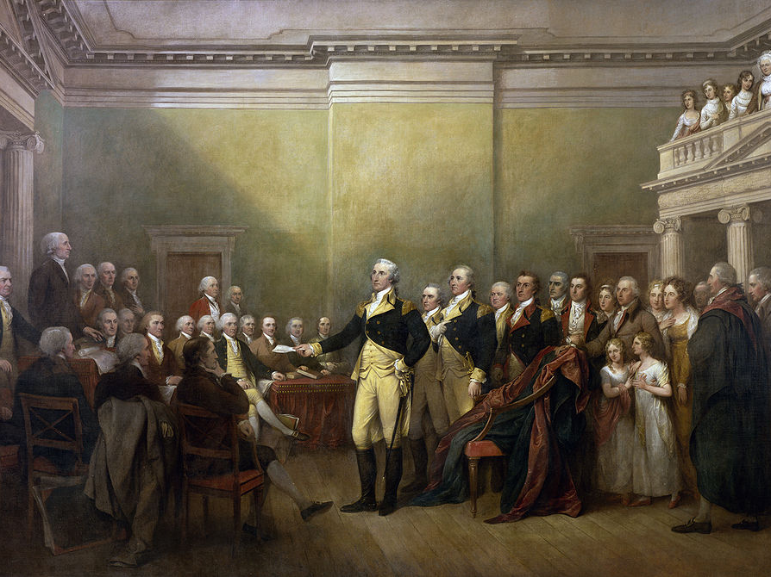
General George Washington Resigning his Commission Trumbell 1817
In this painting it gives George Washington a sense of power and is the figure that stands out than most. Notice the light helps in the creation of giving Washington the figure of attention. Also it gives a monarch feel to him which shows that he has great power, but does not want it completely.

Slide 8
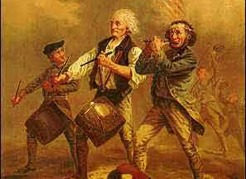
"The Spirit of '76“ painted in 1875
Archibald McNeal Willard
For this piece of art and write down the answer on the Worksheet.
What type of colors are used when looking at the artwork?
Where does your eyes go? What is the center of attention?

Slide 9
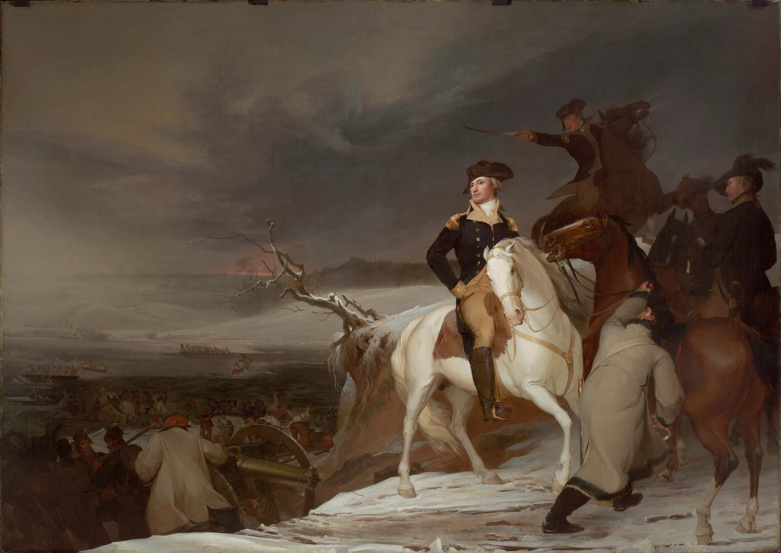
The Passage of the Delaware 1819
Thomas Sully, American (born in England), 1783–1872
Look at the painting. What do you think the message that the artist is trying to give?
How is Washington portrayed in this image?

Slide 10
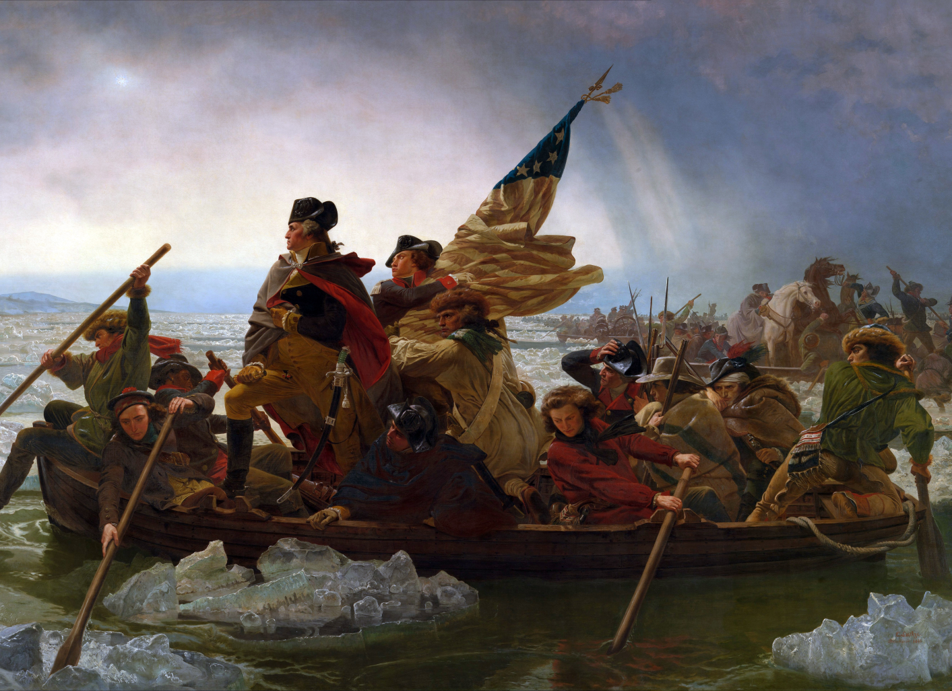
Washington Crossing the Delaware (1851), by Emanuel Leutze. Metropolitan Museum of Art, New York City.
Now analyze this image on your own.

Slide 11
References
http://www.mfa.org/collections/object/the-passage-of-the-delaware-31231
http://americanrevolution.org/artmain.html
http://allthingsliberty.com/wp-content/uploads/2013/01/Declaration-of-Independence-by-John-Trumbull.jpg
http://upload.wikimedia.org/wikipedia/commons/7/75/General_George_Washington_Resigning_his_Commission.jpg
http://americanrevolution.org/trumbio.html
http://upload.wikimedia.org/wikipedia/commons/9/95/Washington_Crossing_the_Delaware_by_Emanuel_Leutze,_MMA-NYC,_1851.jpg

